Slide 1

Collection Best Practices
C# Tips

Slide 2
Collection Best Practices
Use IEnumerable, IReadOnlyCollection, or IReadOnlyList:
Choose IEnumerable<T> if the consumer only needs to iterate through the collection, IReadOnlyCollection<T> for access with a known count, or IReadOnlyList<T> for indexed access.
Avoid returning null:
Return an empty list or enumerable instead of null to prevent null reference exceptions.
Return Immutable Collections:
For safety and to prevent modifications, consider using immutable collections. This ensures the data you expose cannot be altered.
Consider Thread Safety:
Ensure safety for enumerations in multi-threaded environments where other threads may alter the collection.

Slide 3
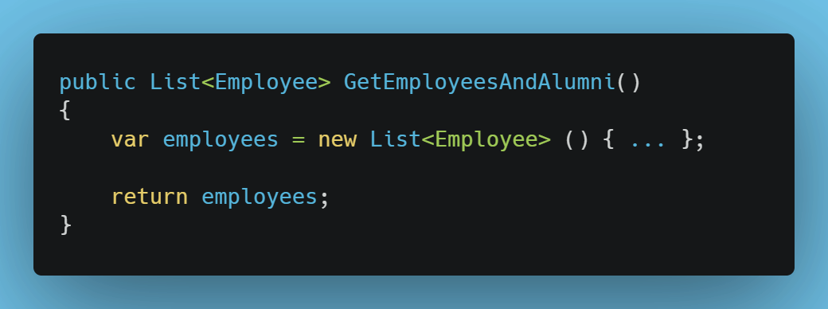
Bad Example

Slide 4
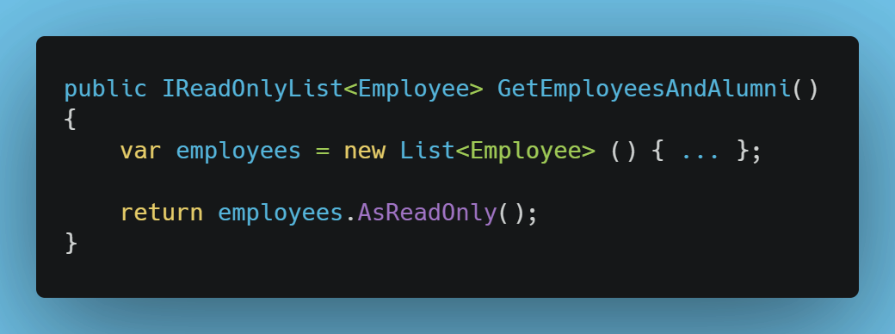
Good Example

Slide 5
Get more tips at WickedProgrammer.com

